Slide 1


Presentation to our marvelous colleagues at James Kerney Campus
November 13, 2012

Slide 2

What is MercerOnline?
Responsible for all online credit courses offered by MCCC.
First online classes offered in 1997.
Called “Virtual Campus” until 2008, when name was changed to “Virtual College.”
Renamed to MercerOnline in 2012.

Slide 3

Services Offered
Design, development, and support of online courses.
Orientation of new online students. (In person, live online, and via interactive web presentation.)
VIC101: Intensive Training Course for Prospective Online Faculty
(2-3 times annually)
Office staffed Monday – Friday 8:00 – 5:00pm
Round the clock support for students and faculty via e-mail
when college is closed (Evenings, weekends, hurricanes, snowstorms, winter break, etc.)
Strong Social Media presence.
(Facebook, Twitter, YouTube)

Slide 4

Who is MercerOnline?
Linda Scherr – Dean of Instructional Effectiveness
Michael Sullivan – Director, MercerOnline
Alexandra Salas – Instructional Designer
Jill Marcus - Coordinator
Karen Wahl – Analyst
Vicente Erazo – Administrative Specialist
Rodney Hargis – Analyst

Slide 5

FALL 2012 at a glance
During the Fall 2012 semester, MercerOnline is running 73 unique fully online classes and over 100 total sections.
Another 200+ courses have ANGEL components which supplement their face-to-face classes.
3,607 students were enrolled in classes which used ANGEL in some form or another.

Slide 6

Recent Initiatives:
Fully Online Programs
Associate in Arts Degree in Liberal Arts & Sciences
    Liberal Arts
    Liberal Arts – Humanities Concentration
    Liberal Arts – Social Science Concentration
Associate in Science
    Criminal Justice – Corrections Option
Associate in Applied Science Degree in Business Management
    Business Studies

Slide 7

Recent Initiatives: eTutoring
In Spring 2012, MercerOnline piloted an online tutoring program.
Working with the Connecticut Distance Learning Consortium, online tutoring was offered to students in select classes.
Initiative expanded in Fall 2012 to include all writing-intensive MCCC online classes.

Slide 8
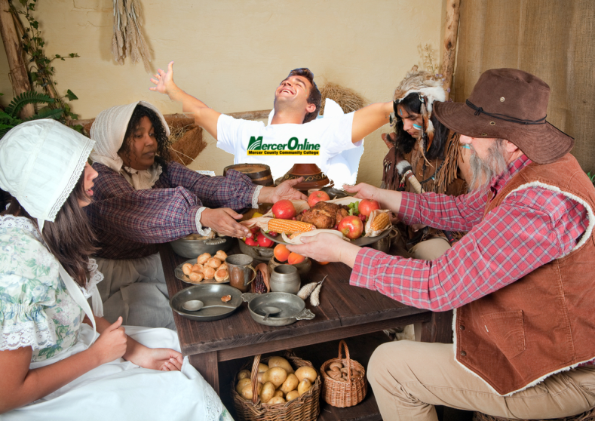
Recent Initiatives:
New Courses
BIO106 (Human Anatomy): MCCC’s first fully-online lab science course.
ART125 (Topics in Contemporary Art): MCCC’s first fully-online Art course.
SPA101/102, LAT101/102 (Beginning Spanish and Latin): Fully online language courses.

