Slide 1
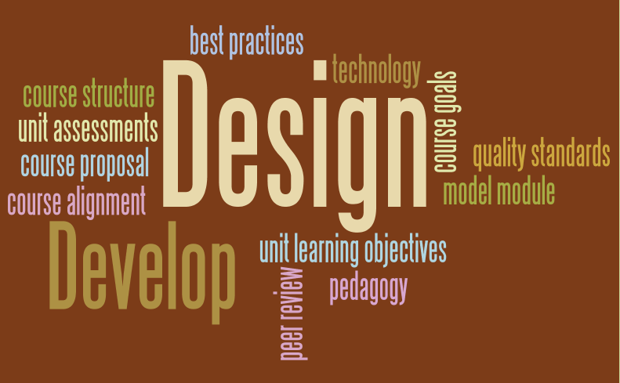
Module 1: Course Design
Created using: Wordle, http://www.wordle.net/

Slide 2
Course design & development process
Stage 1: Proposal
Stage 2:
Alignment
Stage 3:
Course
Structure
Stage 4:
Model
Module
Stage 5:
Develop
Course
Stage 6:
Peer Review
There are 6 Stages in the course design and development process for an online course. Here’s a description of each . . .

Slide 3
Stage 1
Stage 1:
Complete the Online Course Proposal
Stage
2
Stage
3
Stage
4
Stage
5
Stage
6
Plans for your online course.
Instructional and assessment strategies (pedagogy).
Transition considerations from face-to-face to online delivery.
Approval from Division Dean and Virtual College Asst. Dean.
Completed when there is a NEW online course offering in department.
Consultation with the Instructional Designer in the Virtual College.

Slide 4
Stage 2
Stage
1
Stage 2:
Prepare the Course Alignment Document
Stage
3
Stage
4
Stage
5
Stage
6
Based on the Departmental Course Outline (with the course coordinator).
Define Course Competencies/Goals, General Education Knowledge Goals, and MCCC Core Skills.
Define Unit Student Learning Objectives (aligned with course goals/skills).
Define Unit Student Assessments (aligned with SLOs).
Define the Grading Scale (aligned with student assessments).
Consultation with the Instructional Designer in the Virtual College.

Slide 5
Stage 3
Stage
1
Stage
2
Stage 3:
Create the Course Structure (Online)
Stage
4
Stage
5
Stage
6
Based on the Course Alignment document (stage 2) and structure (stage 3).
Goal: create one seamless online learning environment for students.
Create the “Folder” structure in the online Master course for ALL modules.
Includes mapping out modules and sub-modules, as needed, and other “placeholders” such as mid-semester and end-of-semester surveys.
No development of course content during this stage.
Consultation with the Instructional Designer in the Virtual College.

Slide 6
Stage 4
Stage
1
Stage
2
Stage
3
Stage 4:
Develop the “Model” Module (online)
Stage
5
Stage
6
Based on the Course Alignment document (stage 2 – student assessments).
For one “Unit,” develop a complete module that includes all course content: unit learning objectives, lecture/presentation, activities, media, resources, and/or assessments.
Serves as the “model” module (sample) for course development of the entire online course.
Consultation with the Instructional Designer in the Virtual College.

Slide 7
Stage 5
Stage
1
Stage
2
Stage
3
Stage
4
Stage 5:
Develop the
Online Course
Stage
6
Based on the Model Module as the sample (stage 4).
Develop all content for each module (unit) in the online course: unit learning objectives, lecture/presentation, activities, media, resources, and/or assessments.
Plan module (unit) course completion dates.
Consultation with the Instructional Designer and Virtual College team.

Slide 8
Stage 6
Stage
1
Stage
2
Stage
3
Stage
4
Stage
5
Stage 6:
Final Peer Review
Peer-review and approval of online course by content-expert or course coordinator in the department and Virtual College.
Course meets quality standards and best practices in online learning.
Final revisions, as needed.
Course is completed by deadline so it can be offered as planned.
Course is released and available for student registration!!

Slide 9
Course design & development process
Stage 1: Proposal
Stage 2:
Alignment
Stage 3:
Course
Structure
Stage 4:
Model
Module
Stage 5:
Develop
Course
Stage 6:
Peer Review
Course Design
Course Development
Design/develop the course the semester before it’s offered (6 months lead!)

Slide 10
Course Design: Stage 2
Stage
1
Stage 2:
Prepare the Course Alignment Document
Stage
3
Stage
4
Stage
5
Stage
6
In this training program, you’ll get real-world experience in doing Stage 2 in the course design process with an assignment . . .

Slide 11

Stage 2: course alignment
Course Outline
Course Competencies/Goals
The student will be able to:
General Education Knowledge Goals
Goal
Goal
Goal
MCCC Core Skills
Goal
Goal
Goal
Unit 1 Learning Objectives
The student will be able to:
Assignment Description:
To begin, obtain the standard Departmental outline for the course. Please see your course coordinator if you do not have this.
Locate the following in the Course Outline:
Course Competencies/Goals
General Education Knowledge Goals
MCCC Core Skills
Unit Learning Objectives (for each Unit)
This will be needed to prepare the Course Alignment Document for the online course!

Slide 12
Course alignment document
Based on the Course Outline, you’ll prepare the Course Alignment Document to align Course Competencies/Goals, General Education Knowledge Goals, and MCCC Core Skills with the Unit Student Learning Objectives and Unit Student Assessments in the online course.
You will be given a Course Alignment Document “Template” to help you do this assignment. You will:
Cut-and-paste the Course Competencies/Goals, General Education Knowledge Goals, and MCCC Core Skills from the Course Outline into the template.
Define ONE UNIT of study to include Unit Student Learning Objectives and Unit Student Assessments for online delivery.
Click here to view and save the Course Alignment Template.

Slide 13
Assignment: Course alignment document
The Unit Student Assessments, in particular, provide an opportunity to re-design an existing face-to-face course for online delivery.
You’ll want to consider different assessment strategies that you can use in the online course to assess whether students have met the Unit Learning Objectives.
Here are some ideas for brainstorming:
Online Discussion Boards.
Assignments (e.g., research paper, presentations) that can be submitted to the online Drop Box.
Online Quizzes and/or Exams vs. Testing Center.
Online Private Journals for reflection.
Online Activities (e.g., crossword puzzle, games)
Online Chats.

Slide 14
Course alignment document
Want to see some examples with the Course Alignment template filled in to help you with the assignment?
Click on the links below to view two samples from a Course Alignment Document:
Spanish 101 Online Course
Philosophy 102 Online Course
The Course Alignment Assignment with resources can be found under the Module 1 – Online Session – Design Checkpoint folders in ANGEL.
Important! This stage of the course design process provides quality assurance and a strong foundation to develop the online course based on sound pedagogy!

