Slide 1
BIO 201 Lab 7 Experiments 9, 10, 11 & 12 Results
Professor Diane Hilker

Slide 2
Overview
Exp. 9: The Effect of pH on Growth of Microbes
Exp. 10: The Effect of Osmotic Pressure on Microbes
Exp. 11: The Effect of Ultraviolet Light on Bacteria
Exp. 12: Oxygen Requirements for Growth of Microbes

Slide 3
I. Exp. 9: pH & Growth
Purpose: To determine the effects of pH on certain microorganisms.
Acidophile: microbes that grow at a low pH (less that pH 7)
Alkalophile: microbes that grow at a high pH (greater that pH 7)
Most bacteria prefer a neutral pH (pH 7)
Most fungi prefer an acidic pH

Slide 4
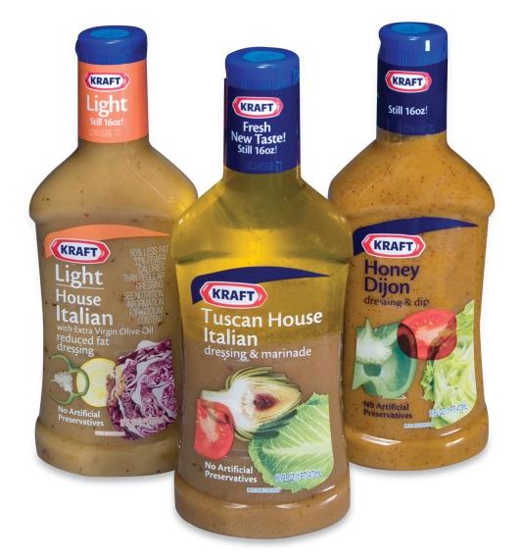
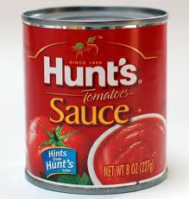
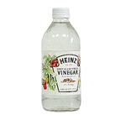
I. Exp. 9: pH & Growth
Food can be preserved with low pH solutions
Vinegar
Lemon Juice
Tomato Sauce

Slide 5
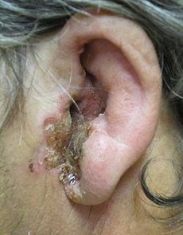
I. Exp. 9: pH & Growth
Certain diseases can be treated or prevented by lowering pH
Urinary Tract Infections: Cranberry Juice
Vaginitis: vinegar douches
Swimmer’s ear (Otitis externa):
vinegar/rubbing alcohol ear drops
Pseudomonas sp.

Slide 6
I. Exp. 9: pH & Growth
Fill in Table 3 with +’s and –’s
Which microbe is an acidophile?
Which microbe is an alkalophile?

Slide 7
Overview
Exp. 9: The Effect of pH on Growth of Microbes
Exp. 10: The Effect of Osmotic Pressure on Microbes
Exp. 11: The Effect of Ultraviolet Light on Bacteria
Exp. 12: Oxygen Requirements for Growth of Microbes

Slide 8
II. Exp. 10: Osmotic Pressure & Growth
Purpose: To determine the salt tolerance of different microorganisms.
Refer to Unit 4 Lecture Notes
What is Osmotic Pressure?
What moves across the semi-permeable membrane, the solvent or solute?

Slide 9
II. Exp. 10: Osmotic Pressure & Growth
Isotonic: no movement of H₂O in or out of the cell
Hypotonic: H₂O enters the cell
Cell will swell and then burst
Hypertonic: H₂O leaves the cell
Cell shrinks-cell membrane pulls away from the cell wall
Bacteriostatic state created

Slide 10
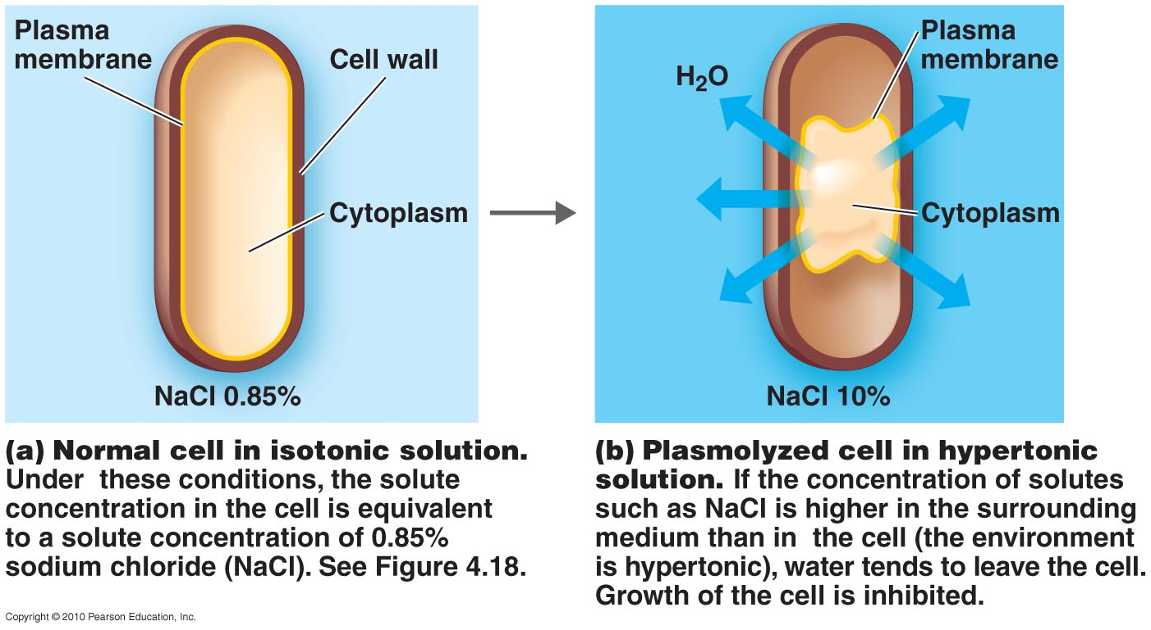
II. Exp. 10: Osmotic Pressure & Growth

Slide 11
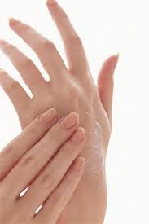
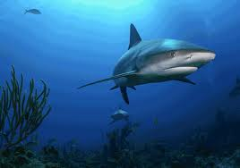
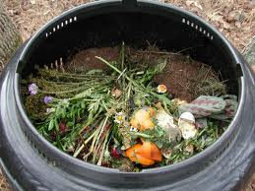
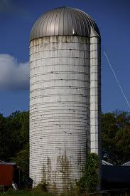
II. Exp. 10: Osmotic Pressure & Growth
Osmophiles: love hypertonic solutions
Halophile: loves salt
Found in the oceans
and on skin
Saccharophile: loves
sugar or carbohydrate

Slide 12
II. Exp. 10: Osmotic Pressure & Growth
Fill in Table 4 with +’s and –’s
Which microbe is a halophile?

Slide 13
Overview
Exp. 9: The Effect of pH on Growth of Microbes
Exp. 10: The Effect of Osmotic Pressure on Microbes
Exp. 11: The Effect of Ultraviolet Light on Bacteria
Exp. 12: Oxygen Requirements for Growth of Microbes

Slide 14
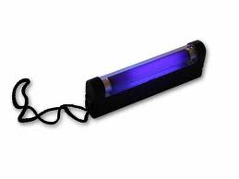
III. Exp. 11: UV Light
Purpose: To determine the effects of UV light on certain microorganisms.
Prevents replication and function of DNA
Limited uses: can’t penetrate surfaces
Used to sterilize:
Surfaces such as tabletops, instruments, and goggles
Atmosphere of enclosed areas like operating rooms
Protect eyes

Slide 15
III. Exp. 11: UV Light
Fill in Table 5 with +’s and –’s
Which microbe requires longer periods of time to eliminate it? Why?

Slide 16
Overview
Exp. 9: The Effect of pH on Growth of Microbes
Exp. 10: The Effect of Osmotic Pressure on Microbes
Exp. 11: The Effect of Ultraviolet Light on Bacteria
Exp. 12: Oxygen Requirements for Growth of Microbes

Slide 17
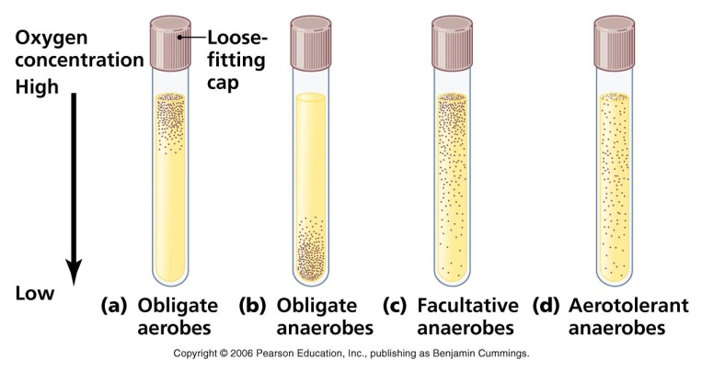
IV. Exp. 12: O₂ Requirements for Growth
Purpose: To determine the effects of oxygen on the growth of certain microorganisms.
Refer to Unit 4 Lecture Notes
Aerobes: require O₂ for growth
Anaerobes: killed in the
presence of O₂
Facultative: can grow in the
presence or absence of O₂

Slide 18
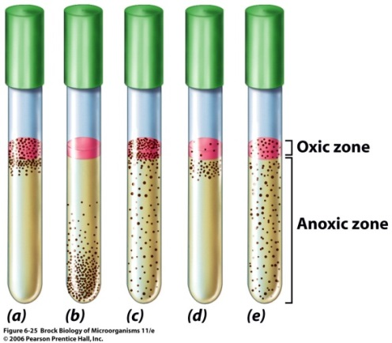
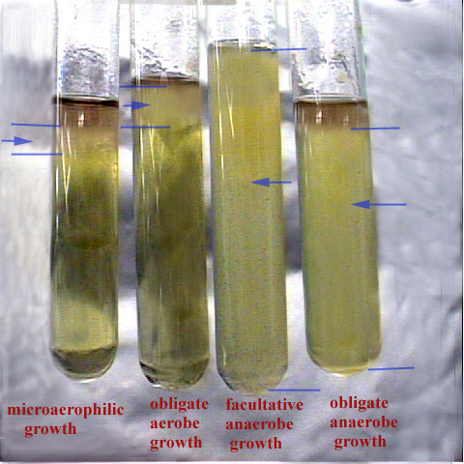
IV. Exp. 12: O₂ Requirements for Growth
2 Culture Media Tubes Used:
Fluid Thioglycollate Broth
Brewers Anaerobic Agar Deep
2 chemicals found in both tubes:
Thioglycollate: removes O₂
Resazurin: O₂ Indicator
O₂ Present: pink/purple color
No O₂: colorless

Slide 19
IV. Exp. 12: O₂ Requirements for Growth
Fill in Table 6 with +’s and –’s
Which microbes are aerobes, anaerobes or facultative?
What does a hyperbaric chamber do and what type of microbes would be eliminated by this device?

Slide 20
BIO 201 Lab 7-New Exp. Experiments 23, 24 & 25
Professor Diane Hilker

Slide 21
Overview
Exp. 23: Transformation of E. coli -discussed last
Exp. 24: Immunology: Agglutination with Latex Beads
Exp. 25: Parasitology

Slide 22
Overview
Exp. 23: Transformation of E. coli -discussed last
Exp. 24: Immunology: Agglutination with Latex Beads
Exp. 25: Parasitology

Slide 23
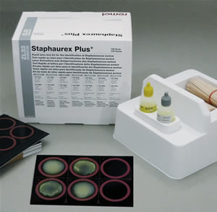
II. Exp. 24: Agglutination with Latex Beads
Purpose: To perform an agglutination procedure and to determine what species of Staphylococcus is present on a Petri plate
Immunology Experiment: Antigens and Antibodies
Staphaurex ^{R} Test Kit:
S. aureus vs. S. epidermidis

Slide 24
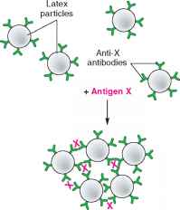
II. Exp. 24: Agglutination with Latex Beads
Antibodies on beads will recognize
S. aureus only
Positive Reaction:
Agglutination or clumping
S. aureus present on plate
Negative Reaction:
No agglutination or smooth appearance
Not S. aureus
S. epidermidis present on plate
Demonstration by instructor

Slide 25
Overview
Exp. 23: Transformation of E. coli -discussed last
Exp. 24: Immunology: Agglutination with Latex Beads
Exp. 25: Parasitology

Slide 26
III. Exp. 25: Parasitology
Purpose: To be able to observe different types of parasitic helminths
Observe Preserved Specimens
Observe Prepared Slides: Scan Power/Clean Slide
Observe a Live Worm: Vinegar Eels (Turbatrix aceti)
2 Types of Parasitic Worms:
I. Platyhelminths: Flatworms
Tremodes or flukes
Cestodes
II. Nematodes: Roundworms

Slide 27
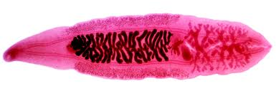
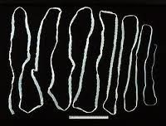
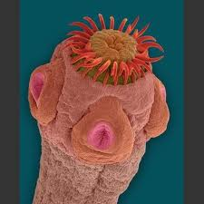
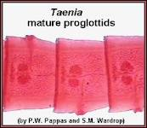
III. Exp. 25: Parasitology
I. Platyhelminths
1. Clonorchis: fluke
2. Taenia sp.: tapeworm
a. Scolex: head
b. Proglottids: segments (male & female organs)

Slide 28
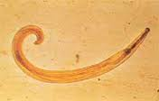
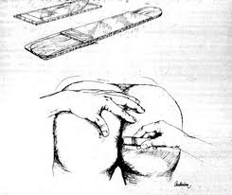
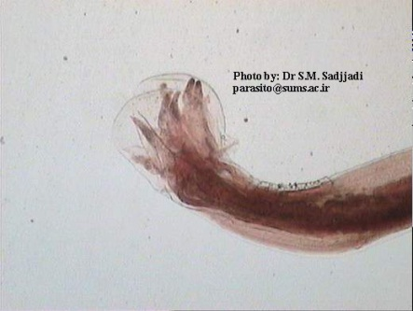
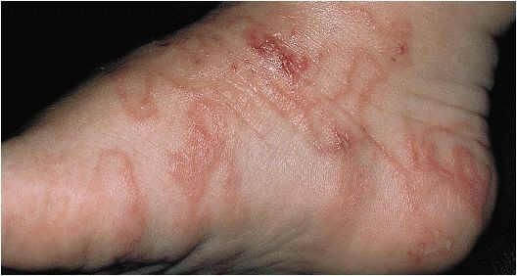
III. Exp. 25: Parasitology
II. Nematodes
1. Enterobius: pinworm
2. Necator: hookworm

Slide 29
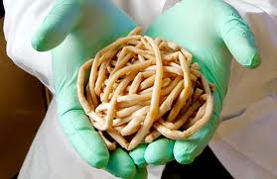
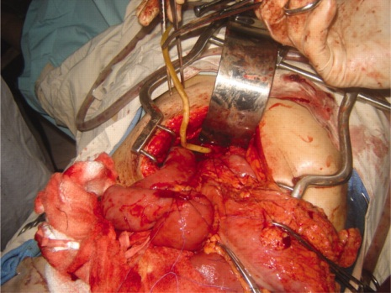
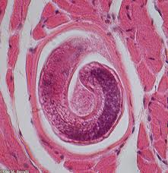
III. Exp. 25: Parasitology
II. Nematodes
3. Ascaris:
4. Trichinella sp.: muscle biopsy

Slide 30
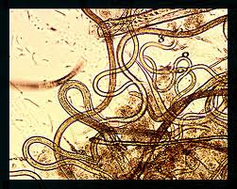
III. Exp. 25: Parasitology
II. Nematodes: Live Worm
5. Vinegar eels: Turbatrix aceti
Non-pathogenic
Need a low pH
Found on fermented apples and
non-pasteurized vinegar

Slide 31
Overview
Exp. 23: Transformation of E. coli
Exp. 24: Immunology: Agglutination with Latex Beads
Exp. 25: Parasitology

Slide 32
I. Exp. 23: Transformation of E. coli
Purpose: To genetically transform E. coli so that it is resistant to the antibiotic ampicillin
Groups of 2-3 students
Materials Needed/group
Follow procedure in Lab Manual
Theory to be discussed in the next lab

