Slide 1
BIO 201 Lab 1 Experiments 1, 2, 3
Professor Diane Hilker

Slide 2
Overview
Exp. 1: Introduction to the Microscope
Exp. 2: Survey of Microbes
Exp. 3: Collection of Microbes

Slide 3
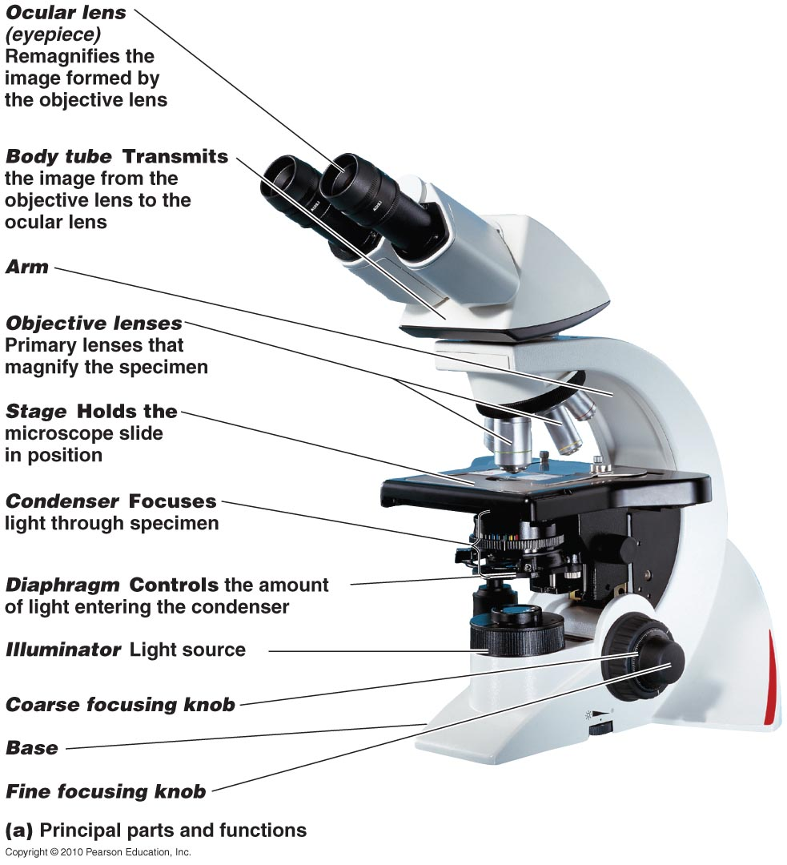
I. Exp. 1: Intro. to the Microscope
Purpose: To review
the use & care of the
compound light
microscope
Fig. 3.1 Textbook

Slide 4
I. Exp. 1: Intro. to the Microscope
Compound Binocular Light Microscope
(2) Sources of Magnification:
Eyepiece or Ocular (10x)
Objectives (4):
Scanning Power: 4 x
Low Power: 10x
High Power: 40x
Oil Immersion: 100x
Parfocal: ability to go from one objective to another with minimal focusing

Slide 5
I. Exp. 1: Intro. to the Microscope
Total Magnification: TM
TM=Magnification of Eyepiece X
Magnification of Objective
 | Eyepiece Magnification | Objective Magnification | TM
Scanning | 10X | 4X | 40X
Low | 10X | 10X | 100X
High Dry | 10X | 40X | 400X
Oil Immersion | 10X | 100X | 1000X

Slide 6
I. Exp. 1: Intro. to the Microscope
Resolution or Resolving Power (RP)
Ability to distinguish detail clearly
To be able to tell 2 points as separate points and not one point
RP = Wavelength of Light = -------
2 X Numerical Aperture 2NA

Slide 7
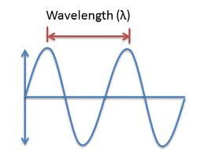
I. Exp. 1: Intro. to the Microscope
Wavelength of light (nm)
Red light = 700 nm
Blue light = 400 nm
RP _{red} = 700 nm = 350 nm
2(1)
RP _{blue} = 400 nm = 200 nm
2(1)
Lower the resolution, better the clarity
Blue filter provides the best resolution with a halogen light bulb
Blue filter NOT needed with microscopes that have
a LED light bulb

Slide 8
I. Exp. 1: Intro. to the Microscope
Numerical Aperture (NA): describes the cone of light that enters the lens so as to see fine detail. Two things make up NA:
Angular Aperture: angle of light as it goes through the lenses & filters of the condenser & into the objective (Constant)
Refractive Index: how light travels through a medium
Refractive Index of Air = 1.0
Refractive Index of Oil = 1.5

Slide 9
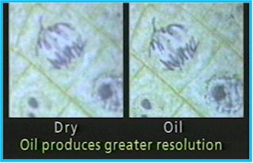
I. Exp. 1: Intro. to the Microscope
RP _{air}= 400 nm = 200 nm
2(1.0)
RP_{oil} = 400 nm = 133 nm
2(1.5)
Better resolution
with oil

Slide 10
Overview
Exp. 1: Introduction to the Microscope
Exp. 2: Survey of Microbes
Exp. 3: Collection of Microbes

Slide 11
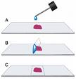
II. Exp. 2: Survey of Microbes
Purpose: To become familiar with using a microscope & to view various microbes
Wet Mount: observing living cells
Focus on edge of coverslip
Scanning-dim light using diaphragm
Move toward center of slide
Observe under Low & High
Powers
Slides will dry out quickly

Slide 12
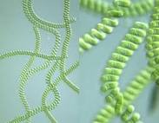
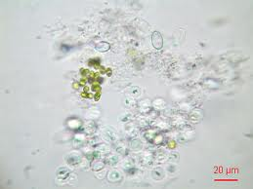
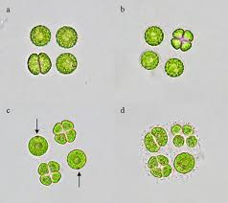
II. Exp. 2: Survey of Microbes
4 Slides: Largest to smallest microorganisms
1. Pond Water: algae-much variation

Slide 13
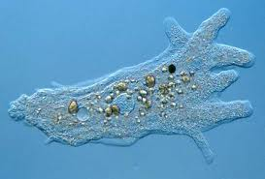
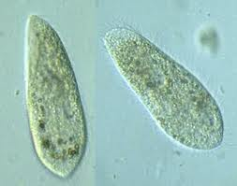
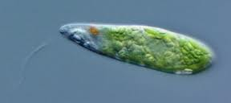
II. Exp. 2: Survey of Microbes
2. Protozoa: single celled eukaryotic microbes
that move by different methods that belong to
the Protista kingdom.
Pseudopods: false feet
Amoeba
Cilia
Paramecium
Flagella
Euglena

Slide 14
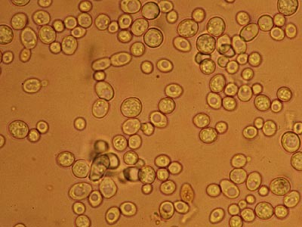
II. Exp. 2: Survey of Microbes
3. Yeast: single celled eukaryotic microbes
that belong to the Fungi kingdom
Ovoid & irregular
Budding: method of
reproduction
Brownian movement
Smaller than protozoa
Larger than bacteria

Slide 15
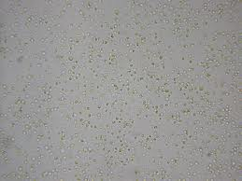
II. Exp. 2: Survey of Microbes
4. Bacteria (Hay infusion ): single celled prokaryotic microbes that belong to the Eubacteria Domain.
Must view under 400x
Very small
Motile & non-motile
Looks like specks of sand
Hard to discern shape
Smaller than yeast
& protozoa
Protozoa may be present in the sample

Slide 16
Overview
Exp. 1: Introduction to the Microscope
Exp. 2: Survey of Microbes
Exp. 3: Collection of Microbes

Slide 17
III. Exp. 3: Collection of Microbes
Purpose: To collect and grow microbes from the environment for observation
Procedure to be described by lab instructor

