Slide 1

Embedding Mathematics into Advanced Careers
New Jersey Entrepreneurship
Summer Teacher Training Institute
July 31, 2013
Facilitator:
Kenna Barger

Slide 2

Session 1 - Key Idea
Rationale for and Introduction to Seven Elements for Developing Math Lessons in CT Project Units

Slide 3
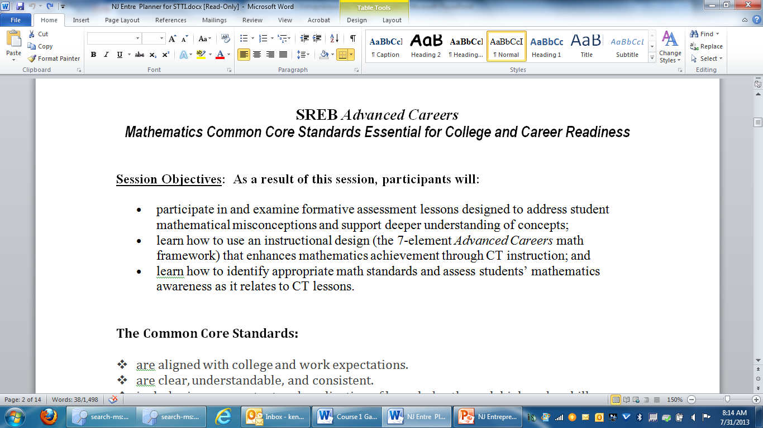

Slide 4
Memory Activity
C
E
H
A
I
B
G
D
F
10 Seconds!

Slide 5
Memory Activity
A B C
D E F
G H I
10 Seconds!

Slide 6
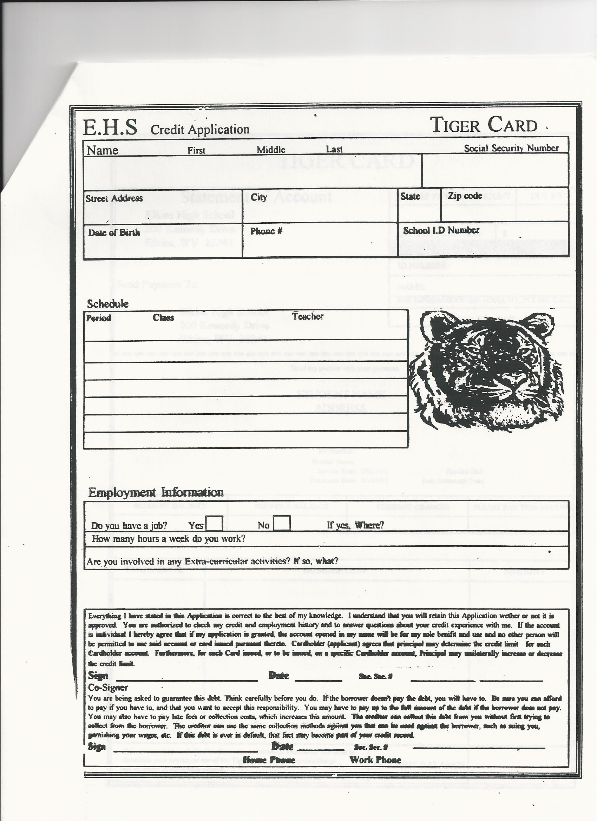

Slide 7
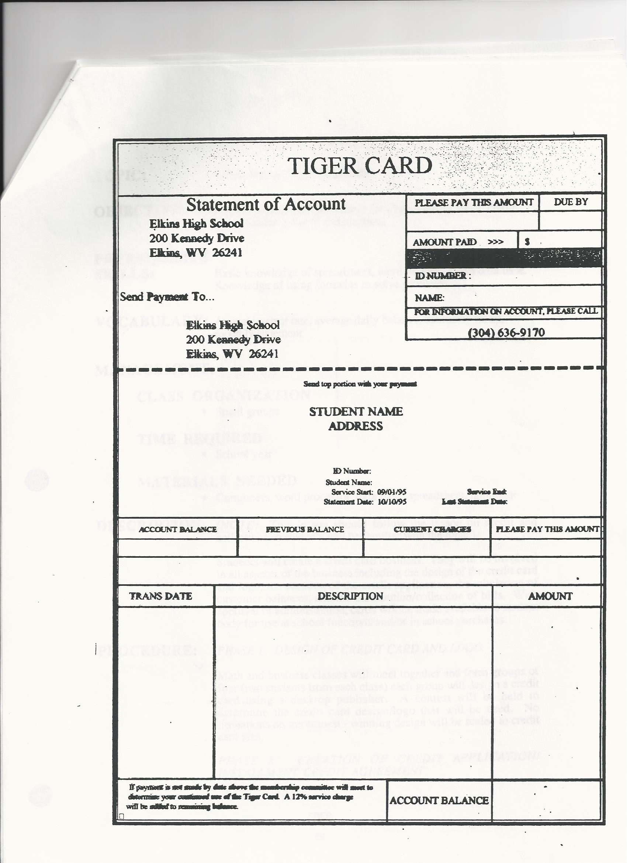

Slide 8
Research Based
Math 7-Element Process:
Based on National Research Center for Career and Technical Education (NRCCTE)
Math in CTE work.
Includes Mathematics Design Collaborative Formative Assessment Lesson format.

Slide 9
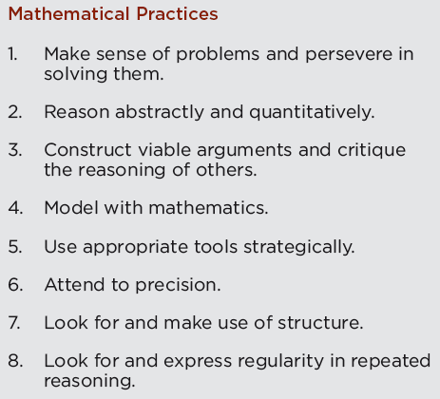
CCSS: Standards for Mathematical Practice
Should be emphasized in ALL projects.

Slide 10
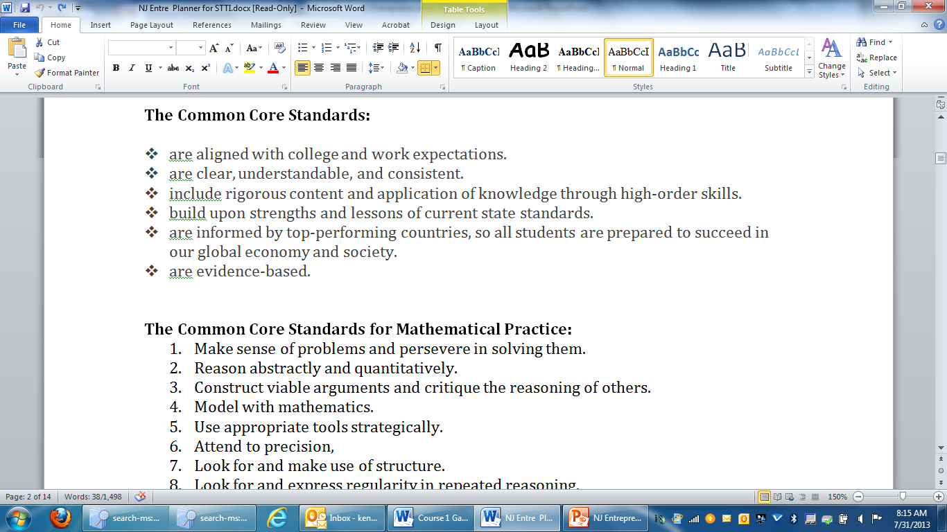

Slide 11

The BIG IDEA of Formative Assessment
Students and teachers
Using evidence of learning
To adapt teaching and learning
To meet immediate learning needs
Minute-to-minute and day-by-day
-Marnie Thompson and Dylan Wiliam (2008)
Notes:
Used to elicit discussion re: definition / understanding of formative assessment. Do we agree? Anything lacking in our current school / classroom formative assessment practices?

Slide 12
The 5 Strategies of Assessment for Learning (Formative Assessment)
Clarifying and sharing learning intentions and criteria for success
Engineering effective discussions, questions and learning tasks that elicit evidence of learning
Providing feedback that moves learners forward
Activating students as the owners of their own learning
Activating students as instructional resources for one another

Slide 13
Math Framework: “7 Elements” for Enhanced CT Programs
Introduce the CT math lesson
Assess math awareness
Work through embedded example
Work through related, contextual example
Work through traditional math examples.
Students demonstrate their understanding.
Formal Assessment
Combining the NRCCTE & MDC Model
Notes:
The National Research Center for CTE offers us a research-based model for embedding mathematics in CT that provides for assessment and is a proven model for CT teachers to use.
SREB has adapted this research-based model placing emphasis on using the formative assessment ideals (and to some degree, structure) of the Mathematics Design Collaborative (MDC).

Slide 14
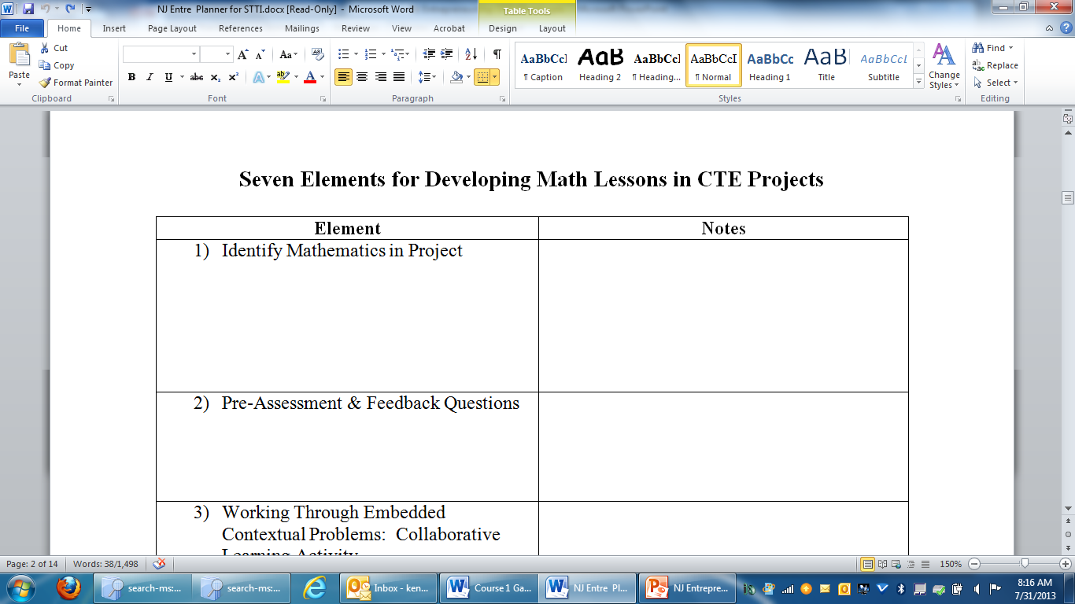

Slide 15
Math Framework: “7 Elements” for Enhanced CT Programs
Element #1: Identify the Math
This happens in two places:
1st Mathematics Common Core College- and Career-
Readiness Standards listing
2nd Within the project (just-in-time) where the math
lesson begins.
Notes:
Refer participants to the Math Enhanced CT 7-Element Framework Guide.
Element #1: Identify the Math
This happens in two places:
1st: Mathematics Common Core College- and Career-Readiness Standards
Since the Common Core Process Standards are expected to be included in ALL of the projects, the standards included here should come from the high school Common Core Content Standards.
Only include standards that are the “focus” of the mathematics required for understanding/completing the project and are imperative to know in the designated field of study. Do not include “peripheral” standards. A good rule of thumb is the following: If the standard is included, there should be a 7-element lesson to accompany it within the project or in a previous project where the standard was identified.
2nd: Within the project (just-in-time) where the math lesson begins.
Prior to the pre-assessment, the teacher should frame for the students that they must be able to apply certain math concepts to be able to accomplish the goals of the project. The mathematics should be stated (using Common Core language as much as possible) and the relationship of the math within the context of the project should be explained. Once this purpose has been described, the teacher should explain that students will now participate in a math enabling learning activity that will make sure they are proficient at the math that has been described and apply it accordingly.
The math described in element #1 should be complete and align with the math that appears in elements #2-#7.

Slide 16
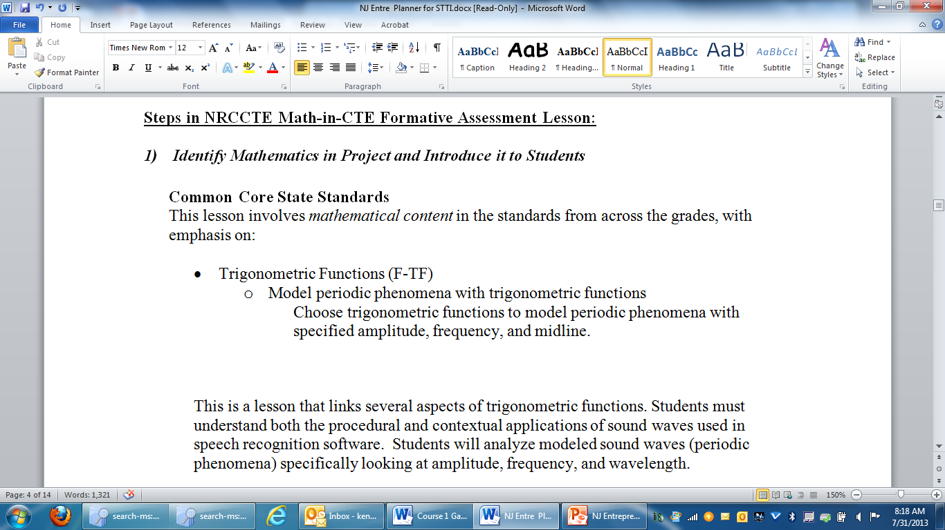

Slide 17
Math Framework: “7 Elements” for Enhanced CT Programs
Element #2: Pre-Assess the Math
Key points:
Pre-assesses the math identified in element #1
Provides evidence of current, individual student knowledge and possible misunderstandings.
Occurs day prior to element #3
Not graded or returned prior to element #5
Notes:
Refer participants to the Math Enhanced CT 7-Element Framework Guide.
Element #2: Pre-Assess the Math
The pre-lesson assessment should include tasks that completely and comprehensively cover the mathematics identified in element #1. Note: This is NOT a pre-assessment of pre-requisite material which is the intent of some other types of pre-assessments.
The pre-lesson assessment should be administered to individual students 10-20 minutes the day prior to the collaborative activity/activities that begin in element #3. This allow the teacher time to review and analyze student work for common misconceptions and gaps in learning regarding the assessed mathematics concepts.
The teacher should stress the importance that students should do their best and completely answer questions/tasks on the pre-lesson assessment so that (s)he can get a good picture of current math understandings. The students will participate in a collaborative activity the following day to help clarify any skills/concepts necessary for understanding.
These should NOT be graded.

Slide 18
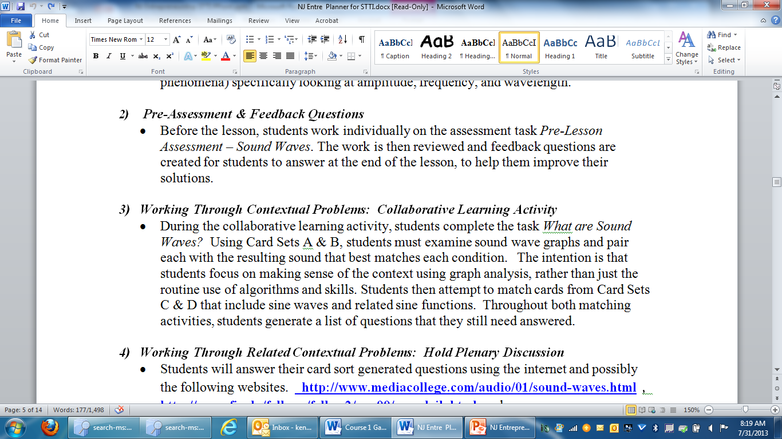

Slide 19
Math Framework: “7 Elements” for Enhanced CT Programs
Element #3: Work Through an Embedded Contextual Example
Key Points:
Collaborative activity in homogeneous groups
Designed to “learn” the math through engagement
Showcased within project context, providing “purpose”
Student driven
Notes:
Refer participants to the Math Enhanced CT 7-Element Framework Guide.
Element #3: Work Through an Embedded Contextual Example
Occurs the day following administration of the pre-lesson assessment.
Intended to include a collaborative activity where students investigate and learn about the math concepts and skills identified in element #1. This should NOT be a worksheet or questions designed to “assess” – rather, this should be a “learning” experience. Among many additional engaging scenarios, delivery options may include: card sorts, station activities, mini-research / share sessions, video or applet investigations.
The collaborative activity should showcase the math within the context of the project / career area, setting the “PURPOSE” for learning.
Generally, homogeneous pairs of students (no more than 3) should investigate the math collaboratively. (These small groups can join with others to share with one another during the plenary discussion phase if desired.)
The teacher should take advantage of opportunities for mini-conferencing with student groups (NOT GPSing) as they are engaged in the collaborative activity.
The collaborative activity should be followed by a whole class plenary discussion where the conversation revolves around student generated questions, performance, and/or misunderstandings.

Slide 21
Math Framework: “7 Elements” for Enhanced CT Programs
Element #4: Work Through Additional Contextual Example(s)
Key Points:
Expand what was learned in element #3 to additional scenario
Deepen understanding in context
Notes:
Refer participants to the Math Enhanced CT 7-Element Framework Guide.
Element #4: Work Through Additional Contextual Example(s)
Work through a second contextual example following the same process as in element #3 OR expand what was learned in element #3 to greater depth / detail. The purpose is to provide additional work with the “learned” math in a second scenario.

Slide 23
Math Framework: “7 Elements” for Enhanced CT Programs
Element #5: Work Through Traditional Math Problems
Key Point:
Increases opportunities for transferability of math concepts / skills identified in element #1 to other contexts
Notes:
Refer participants to the Math Enhanced CT 7-Element Framework Guide.
Element #5: Work Through Traditional Math Examples
The purpose is to increase opportunities for transferability of the math concepts/skills identified in element #1 to other contexts. In order for this to occur, students need to be able to identify and work with the math when it is presented void of the project context.
This does NOT have to be a list of problems in worksheet format. Be creative with how these problems are introduced to students and how they will be engaged with solving them.

Slide 24
Math Framework: “7 Elements” for Enhanced CT Programs
Element #6: Students Demonstrate Their Understanding
Key Point:
Apply the math learning to project deliverables.
Notes:
Refer participants to the Math Enhanced CT 7-Element Framework Guide.
Element #6: Students Demonstrate Their Understanding
Students apply what they have learned in elements #3-5 to the project deliverables.
The project deliverables should require students to showcase mastery of the project’s identified mathematics.

Slide 25
Math Framework: “7 Elements” for Enhanced CT Programs
Element #7: Formal Assessment
Key Points:
Include math problems in the end of project assessment
Problems should be written both in project context and void of context (as they might appear in math classroom)
Notes:
Refer participants to the Math Enhanced CT 7-Element Framework Guide.
Element #7: Formal Assessment
The unit assessment should include items that require student mastery of the identified mathematics presented both within the project context and void of context (traditional).

Slide 26
Session 2 - Key Idea
CT & Math Teacher work collaboratively to find and examine seven element math lessons in Course I projects.

Slide 27
Math Framework: “7 Elements” for Enhanced CT Programs
Introduce the CT math lesson
Assess math awareness
Work through embedded example
Work through related, contextual example
Work through traditional math examples.
Students demonstrate their understanding.
Formal Assessment
Combining the NRCCTE & MDC Model
Notes:
Say to participants:
At this point, your Enhanced CT project scenario has been determined; your project description is written in 4-paragraph format and the essential academic elements have been identified. Let’s begin to develop a 7 element lesson based on the Enhanced CT Math Framework.
The 7 element math lesson should be inserted “just in time” in the project. For example, this often occurs in the testing stage when data is being generated and analyzed.
Team members should identify the high school Common Core math standards (if they haven’t done so already) and begin discussions about the prior experience and common misconceptions students may have about the identified math. Keep these discussions in mind as you develop the pre-assessment, ensuring that opportunities for these misconceptions to emerge (if they exist) are included in the assessment tool. The ensuing elements of the math lesson should, in like fashion, incorporate student driven learning pieces that attend to potential misconceptions about the math identified in element #1.
*Note: There are numerous samples of the type of pre-assessment and engaging collaborative activities that we are looking for in the MDC materials found at the map.mathshell.org website. These lessons, most likely, cannot be directly applied to the CT project because of the need for placing the math into the context of the specific project, but the ideas presented in the FALs are similar and can be used as a resource.
Facilitator rotates throughout the room as the teams develop their 7-element lessons.

